Slide 1
KS3 Electricity Lesson 5
Parallel Circuits

Slide 2
Learning Objective
To investigate current in parallel circuits.
Success Criteria
To identify the differences between series and parallel circuits.
To draw and construct a parallel circuit from a description.
To construct and electrically wire an eco-friendly house.

Slide 3


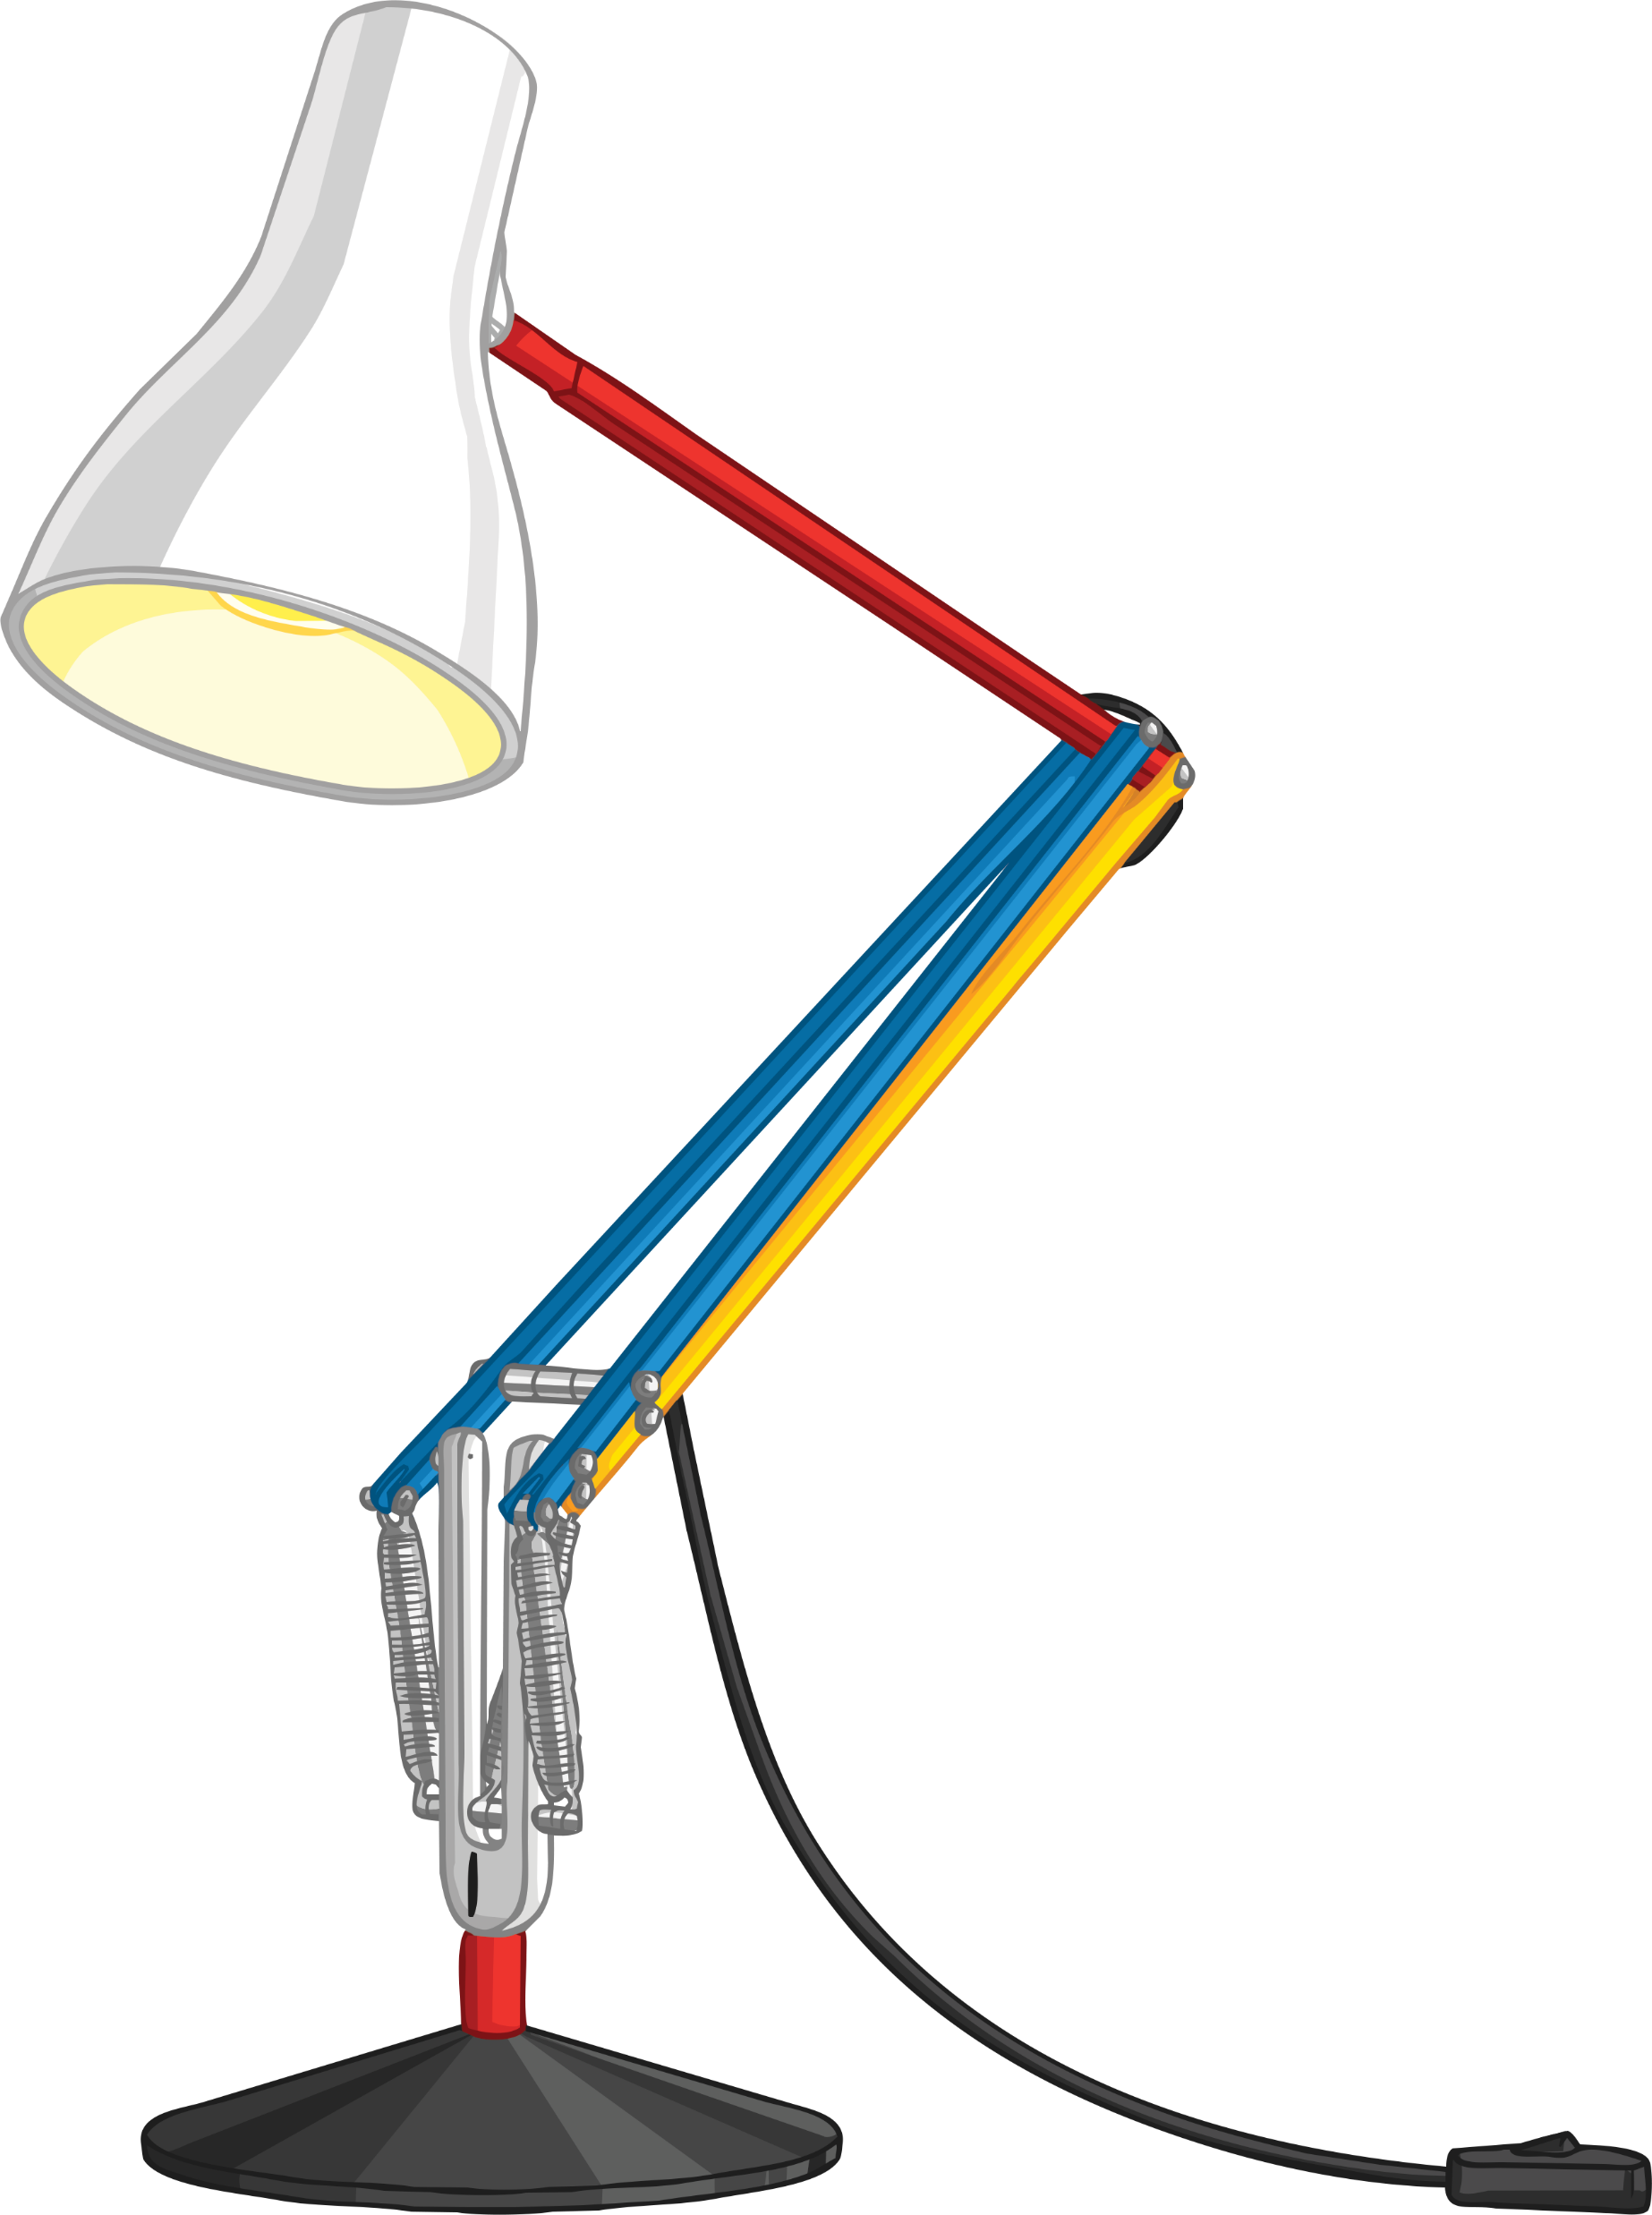
Starter: Lights
A light has blown in my living room. Will this stop the lights in the rest of the house from working?
Are houses wired in a series or parallel circuit? Explain your answer.
Challenge: Write down ideas about the benefits of using parallel circuits over series circuits.

Slide 4

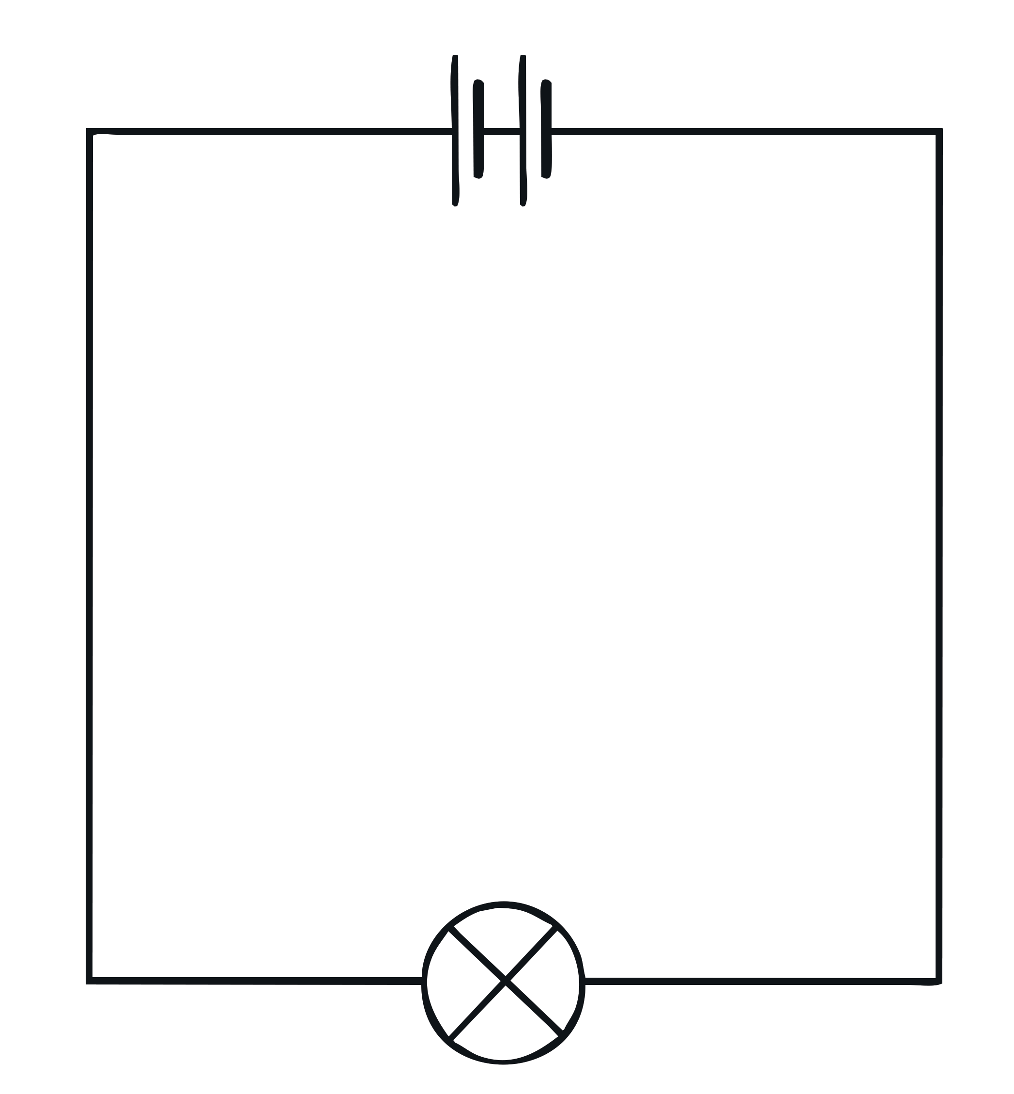
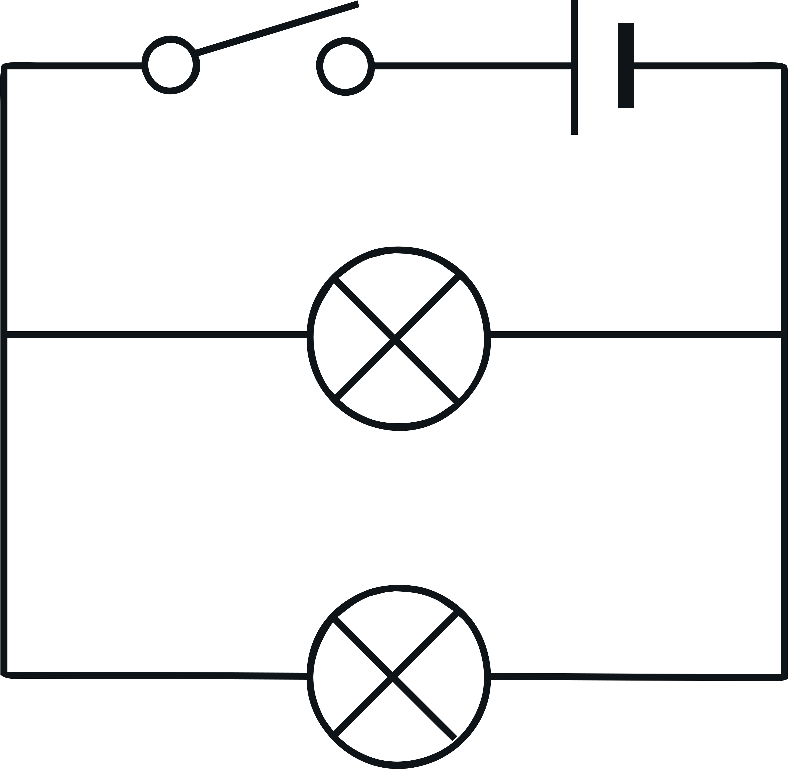
Parallel vs Series Circuits
What differences do you notice between a parallel and a series circuit?
In a parallel circuit, the components are connected side by side. This gives the current several different paths for it to flow around. If one bulb blows, the other bulbs will remain lit as the circuit is still complete.
In a series circuit, the components are connected
end to end in a loop.
If one bulb breaks, the whole circuit will go out and none of the bulbs will light as the circuit is no longer complete.

Slide 5


Building Parallel Circuits
When it comes to drawing parallel circuits, there are certain rules that we must follow every time.
1. Always draw circuits using straight lines.
2. Use a pencil and a ruler to draw these lines.
You will need the following equipment: wires, 1 battery, 4 bulbs, 1 switch.
Using the equipment, you will need to build and draw the following circuits:
Circuit 1 - A parallel circuit with 1 battery, 1 switch, 2 bulbs.
Circuit 2 - A parallel circuit with 1 battery, 1 switch, 3 bulbs.
Circuit 3 - A parallel circuit with 1 battery, 1 switch, 4 bulbs.

Slide 6
Building Parallel Circuits
In your groups, you will need to collect the following pieces of equipment:
wires, 1 battery, 4 bulbs, 1 switch.
Step 1 – Collect the equipment.
Step 2 – Place two of the wires into the connector points at each end of the
battery.
Step 3 – Connect one of the wires to the switch and use the other wire to
connect to a bulb.
Step 4 – Connect a wire between the switch and bulb to create a circuit.
Step 5 – Using another two wires, connect them both to the connection
points on the existing wires either side of the bulb that is in the
circuit.
Step 6 – Connect these wires to another bulb.
Step 7 – Repeat the steps above for each of the circuits, but add an extra
bulb each time.

Slide 7
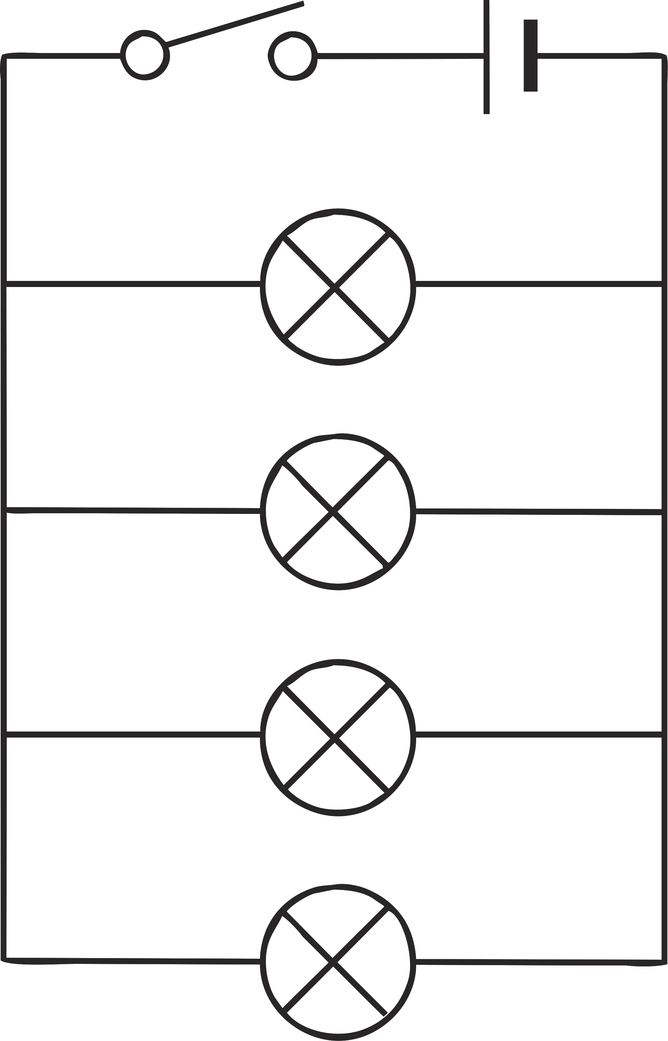
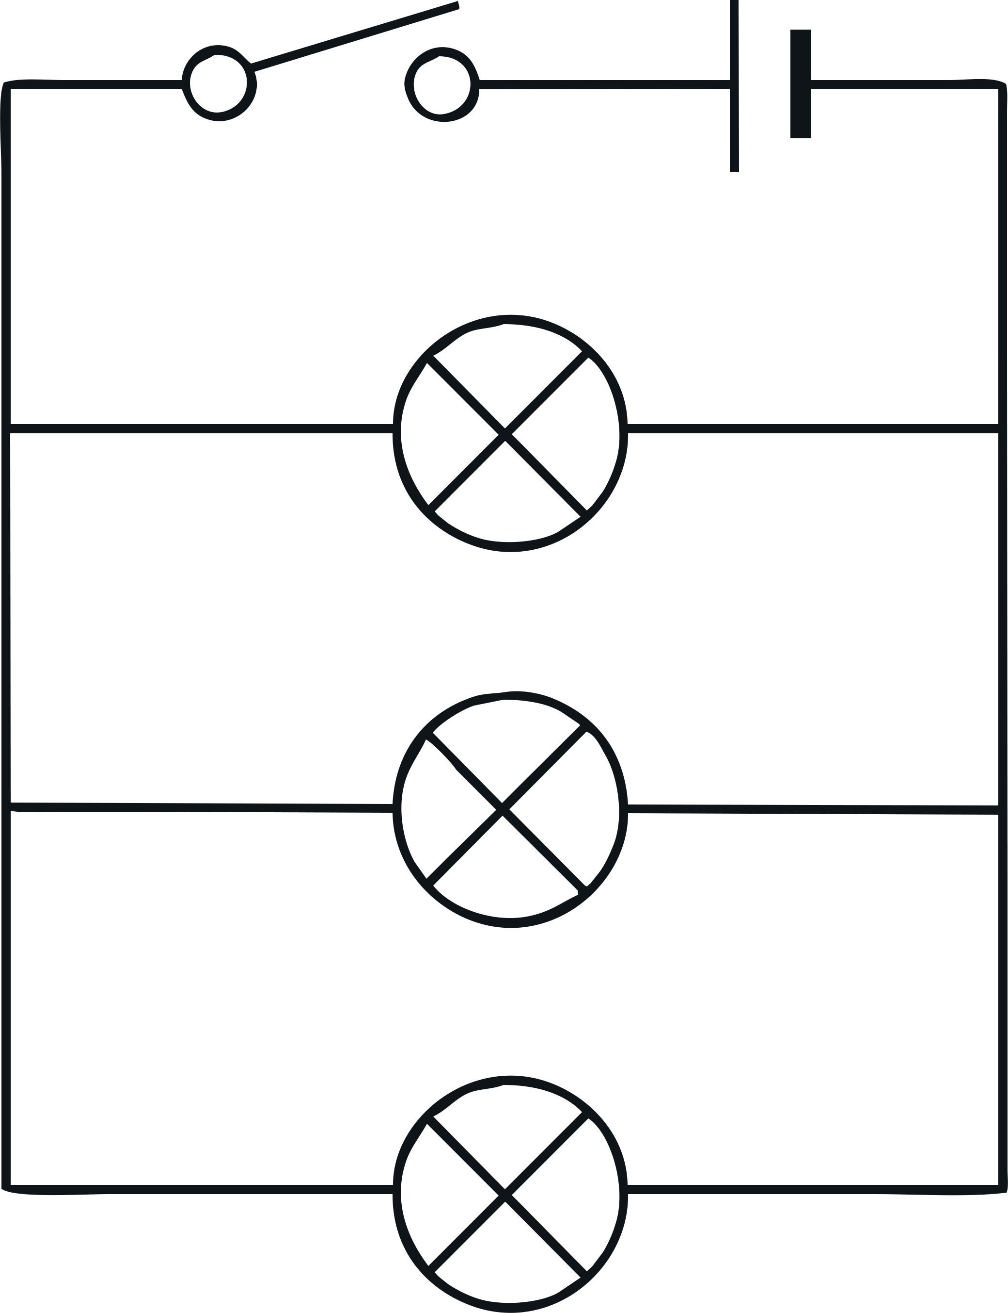
Building Parallel Circuits – Answers
Circuit 1 - A parallel circuit with 1 battery, 1 switch, 2 bulbs.
Circuit 2 - A parallel circuit with 1 battery, 1 switch, 3 bulbs.
Circuit 3 - A parallel circuit with 1 battery, 1 switch, 4 bulbs.

Slide 8
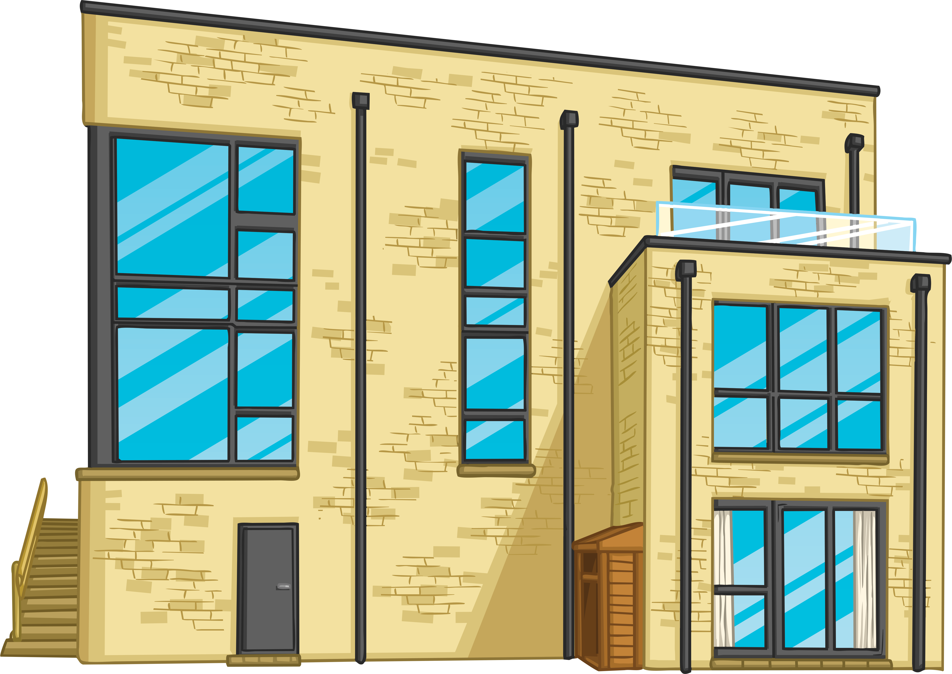
Dream House Construction Project
You are currently the site manager for a local eco-friendly housing development project. The houses are in the early planning phases and will provide luxury accommodation for executives that work in the city.
You have been asked to design, build and provide electrical wiring in each house.

Slide 9

Dream House Construction Project
For every house that is constructed, there are certain rules that must be adhered to.
Inside the house:
There must be at least two separate rooms.
There must be a series circuit with 2 bulbs, 1 battery and 3 wires wired correctly.
There must be a parallel circuit with 2 bulbs, 1 battery, 1 switch and 5 wires wired correctly.
Outside the house:
There must be a parallel circuit with 2 bulbs, 1 battery, 1 switch, 1 buzzer and 6 wires wired correctly.
For each phase of the construction process you will be awarded points. There are 50 points up for grabs.
The ‘house’ must be made of a cardboard box no smaller than the size of a shoe box.

Slide 10
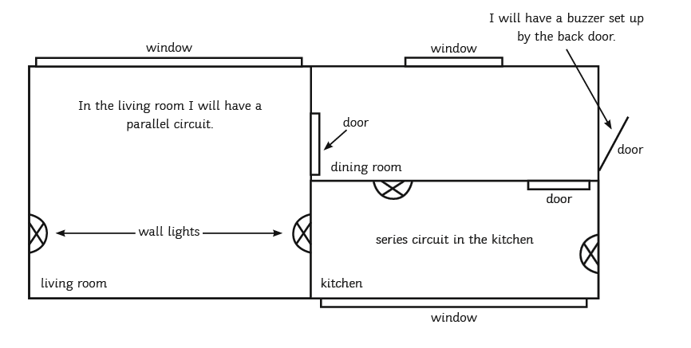
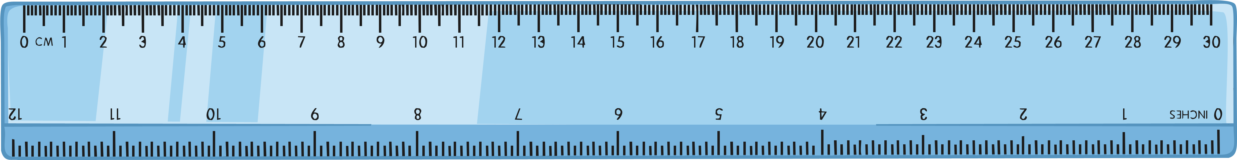
Dream House Design
You now need to create a blueprint for your dream house design. This is a bird’s eye view drawing of how your house will look when you have electrically wired it.
An example of how your bird’s eye view design may look:
Label where your series and parallel circuits will be placed.
Think carefully about where your wires go. You wouldn’t have lots of wiring on show in your own house.
Test your circuit works before fitting it to the inside or outside of the house.
Challenge: Draw an accurately scaled diagram of your house.
Use the scale 1cm:1m.

Slide 11
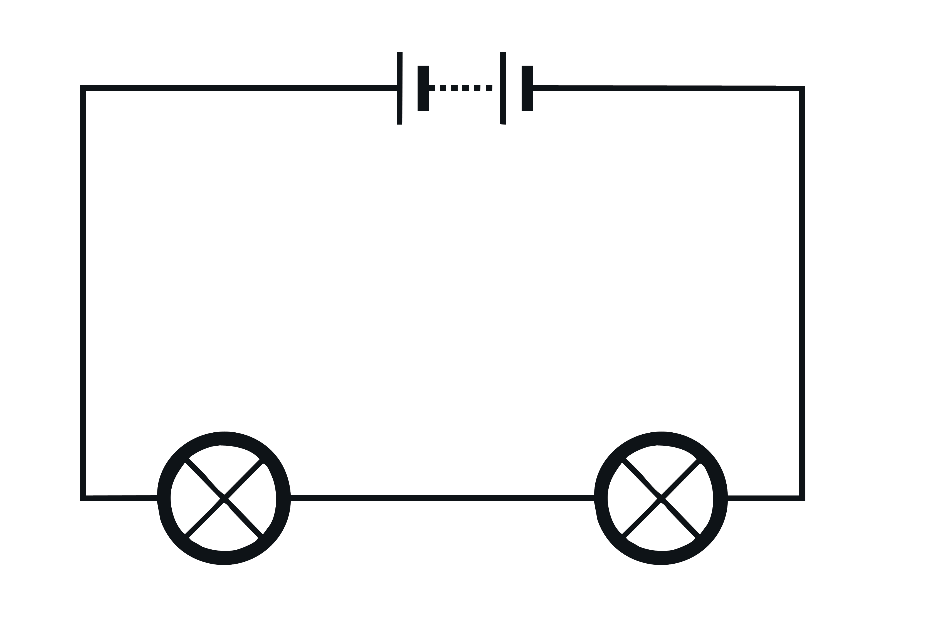
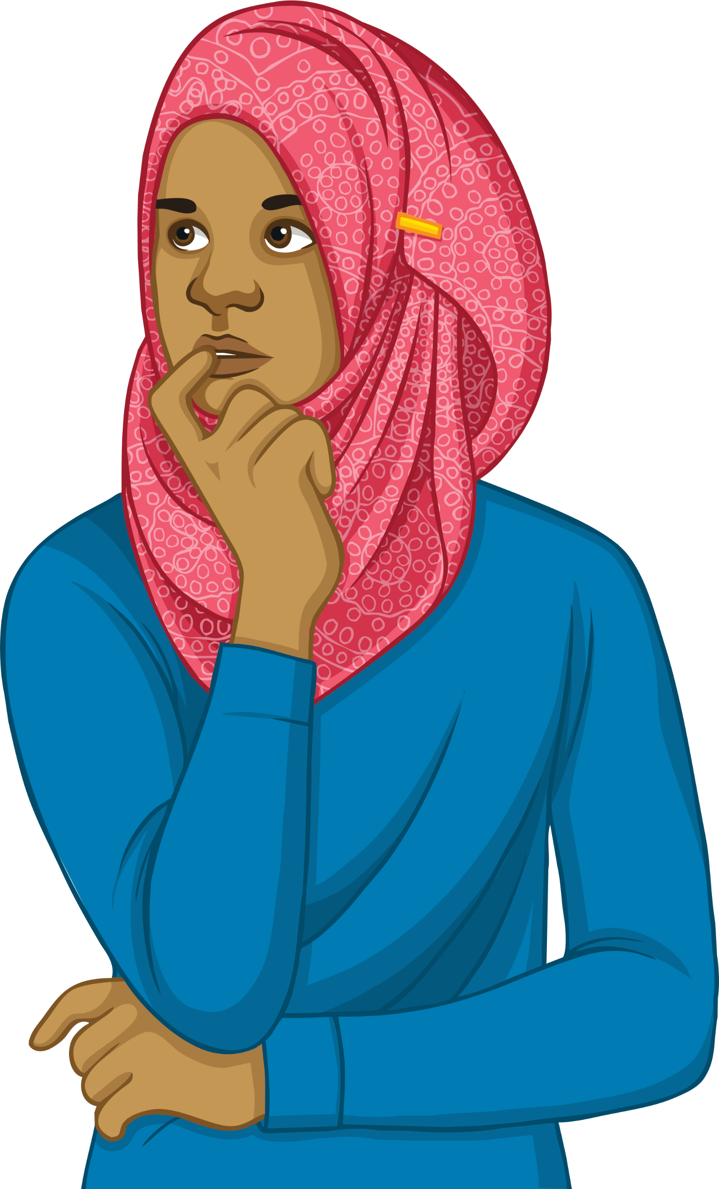
Plenary – Light bulbs
You have made lots of different circuits today.
If you remove one of the bulbs from a series circuit and one from a parallel circuit, what will happen?

